Slide 1
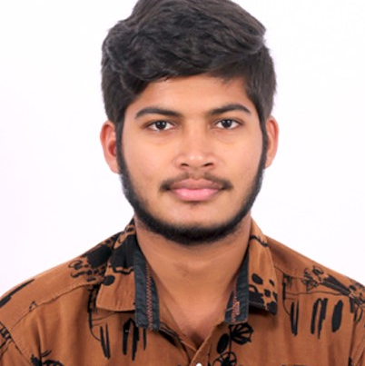
VIVEKANANDA.Y
Bachelor of Technology,Civil-Engineering 2017 - 2021
Analyst/Software Engineer
Bangalore
Skills
VIVEKANANDA.YENNI@CAPGEMINI.COM
Java | Java Basics, OOPS, Generics, Collections, Array, Loops
React | Components, Hooks, Virtual DOM, Routing, Forms & Validation
Database | Mongo DB ,Oracle SQL Server
UI Tech | HTML 5 & CSS 3,bootstrap,javaScript, React js
Tools | Git, Postman, Swagger, Eclipse, Visual Studio Code
Add On skills | Immersive learning
+91 8106673397
A4
Hands on experience on Core Java, SpringBoot Framework, Sql Server.
Proficient in creating Single page Web Application in React with Authentication and Routing.
Hands on experience in developing web pages using HTML5, CSS3,Bootstrap , java Script Reactjs. Good understanding of Document Object Model (DOM) and DOM Functions.
Having knowledge in Manual Testing.
Ready to learn new technologies and implement them for the future knowledge improvement.
Completed Case study on Health-Insurance-System along with API, Swagger, responsive UI with HTML5, CSS, Bootstrap and React used as User Interface.
Degreed: Successfully completed Git&Github, MongoDB.

